Slide 1



Advanced Methods for Gamma Ray Science
K.Kosack and J. Decock
Tino MICHAEL, Thierry STOLARCZYK, Fabio ACERO, Bruno Khélifi, Sandrine Pires, David LANDRIU
Presented by F. Acero
CEA Paris-Saclay – IRFU/Dap
November, 2017

Slide 2


Project Context: group development
Goal of young-team project:
(Europe)
Improve sensitivity of modern ground-based Gamma-ray telescopes
Develop a group to work on gamma-ray techniques locally at AIM/CEA
Improve overlap with related groups
Involve new people in gamma-ray analysis
HESS group
(SAp + SPP)
UnivEarths
Advanced Gamma Project
SAp CTA Group
Other CTA
groups
CosmoStat Group (SAp)
APC Group
(Paris Diderot)
Notes:
Improve the sensitivity fo …
The goal of our project is to make a working group on gamma ray technics in the astrophysics division in CEA
Increase collaboration with others related groups ; for instance we collaborate with …
Involve …

Slide 3
Cross-pollination
Cultural exchange : astrophysics / computer-science
  Came from idea that problems in CosmoStat (e.g. weak lensing) resemble those in gamma-ray astronomy
  Techniques in Gamma-ray astronomy based on particle-physics background
  Best reconstruction use very CPU-intensive, brute force techniques
  Can we do better with more modern signal processing?
Funding was used to hire a post-doc with specialization in computer-science and interest in exploring new techniques
  Some training needed to adjust to world of physics vs computer science, beneficial to all

Slide 4
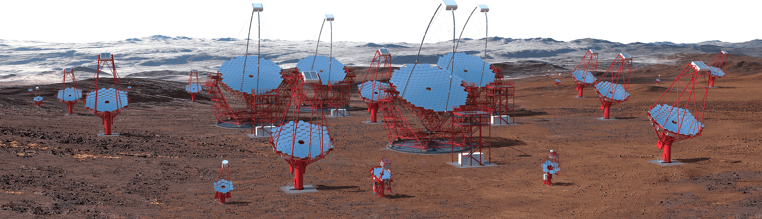
Observatories
Chile & Canary Islands
Notes:
So, as I said, we work on gamma ray observatories,
mainly on HESS and on CTA, the future big Cherenkov Telescope Array

Slide 5
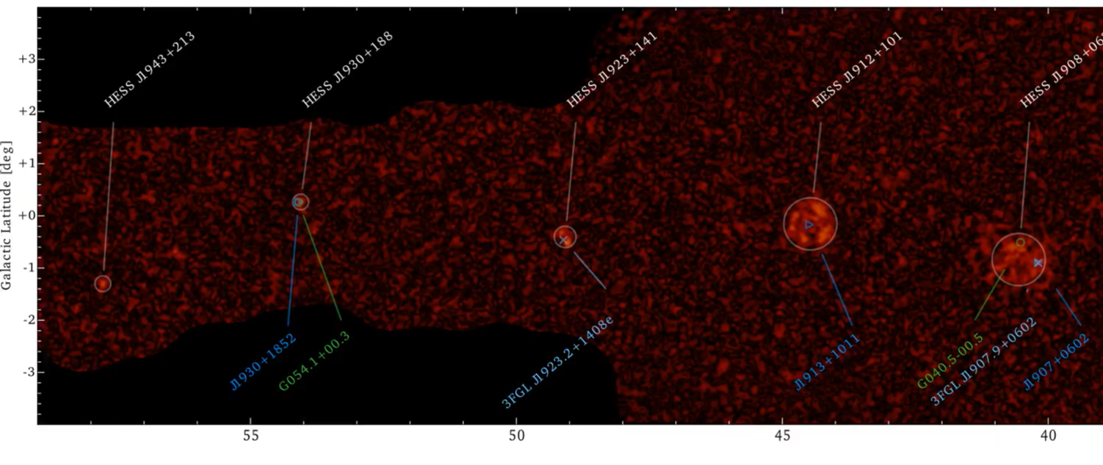
Astronomy at >100 GeV - 100 TeV
Some scientific challenges:
  High-energy sensitivity: spectral Cut-offs (cosmic ray origin)
  Low-energy threshold: most transient and variable sources (AGN, etc)
  Good resolution: resolving details of SNRs (shock acceleration )
The HESS galactic plane survey (HGPS)

Slide 6
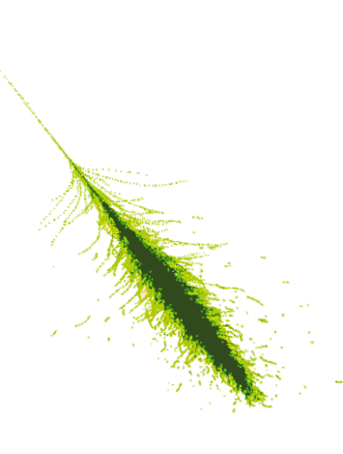
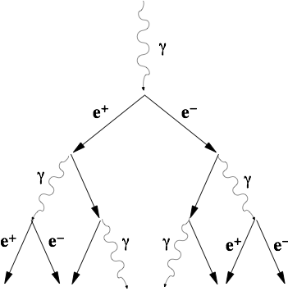
Electromagnetic Showers
photon or e-
≈10 km
Gamma-rays produce air showers
glow in Cherenkov light
detected by very sensitive optical telescopes
200 m
Notes:
Can’t build a tracker in the atmosphere, so do this instead.
use very sensitive photon detectors: PMTs or SiPMs

Slide 7
Electromagnetic Showers
photon or e-
ra,dec
≈10 km
200 m

Slide 8
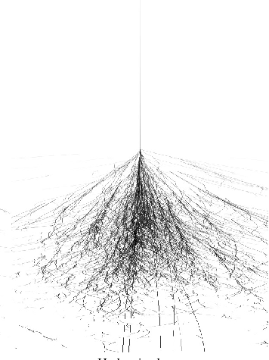
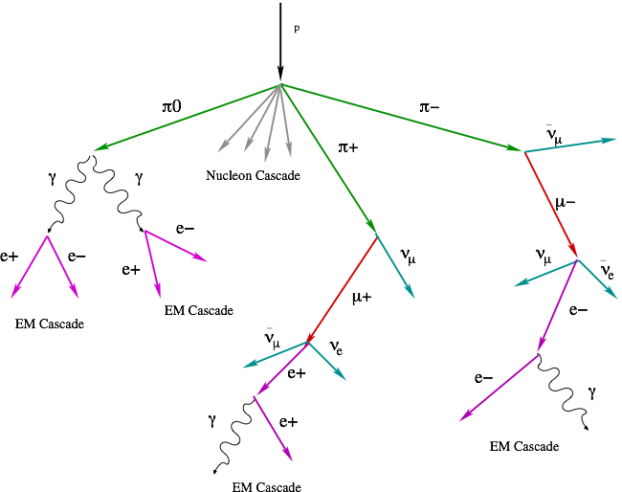
Hadronic Showers
cosmic ray
cosmic ray
≈10 km
EM sub-showers
200 m
Notes:
lots of transverse momentum in hadron showers: rougher images, sub-showers. Reject hadronic showers using their shape in the camera and (hopefully) lack of coherent origin position.

Slide 9
Subject
Try to improve shower image denoising before reconstruction
  Improve methods to remove instrumental and night sky noise
    Keep more signal
    Reduce threshold
Improve full data analysis pipeline from raw to science data!
(large effort, lead by this team)
  Full python-based reconstruction chain to from raw data to sensitivity curve
  Will be basis for CTA data processing pipeline (with UnivEarths attribution)
  Must analyze PBs of monte-carlo shower simulations to produce a sensitivity curve
    Simulated gamma-rays, protons, electrons

Slide 10
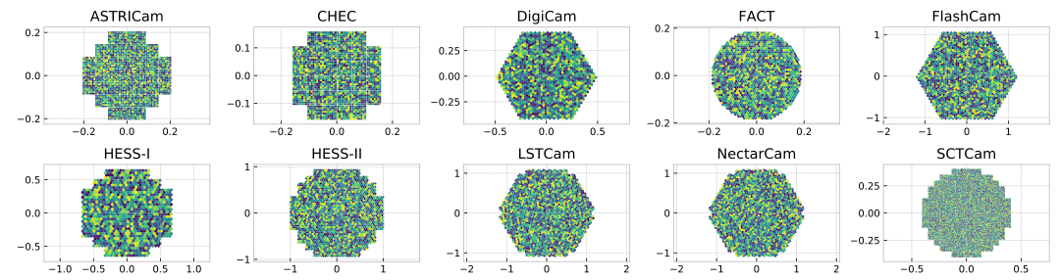
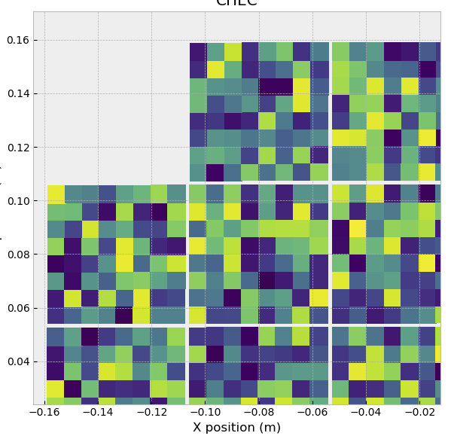
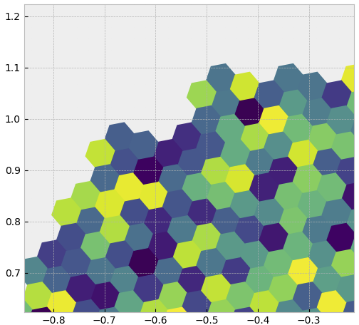
Challenges
Complexity of instruments!
  9 camera geometries in CTA + 3 in HESS!
Photomultiplier tubes vs SiPMs
Hexagonal vs Square pixels
Gaps
Edge effects
Differing readout rates
Multiple gain channels
Notes:
This image cleaning can be challenging as
Instruments images have different shapes
The dynamic range is very large
Some showers are very bright and many showers are very faint
Faint showers have a very low signal to noise ratio
And also the cleaning method has to preserve the features used to discriminate photons to hadrons

Slide 11
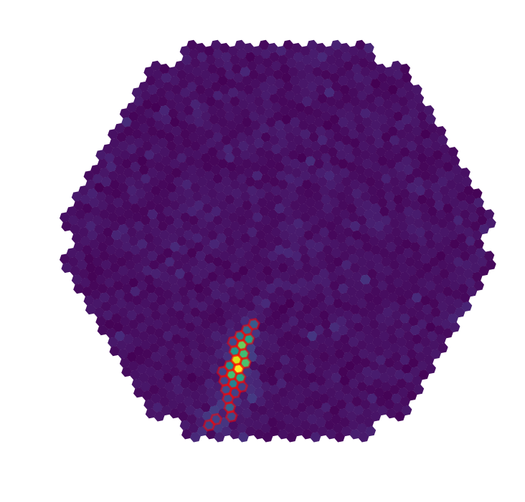
Standard image denoising
A very simple cleaning procedure (HESS setup):
Keep pixels above a given threshold (10 PE)
Keep some neighbors of these selected pixels:
  those above a second (lower) threshold (5 PE)
Notes:
The current method used to clean images in gamma ray observatory is very simple
In HESS this is the so called Tailcut algorithm,
It applies two thresholds on images to remove background noise
It keep pixels above a given threshold,
and then it looks on the neighbors of those pixels and keep also those that are above a second threshold

Slide 12
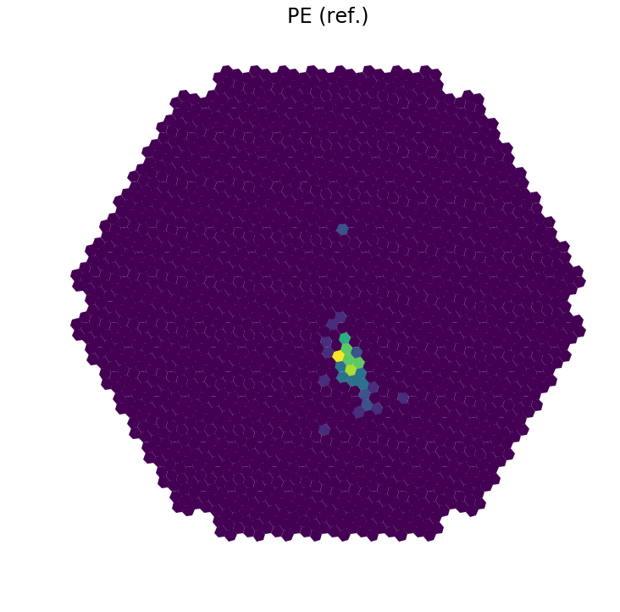
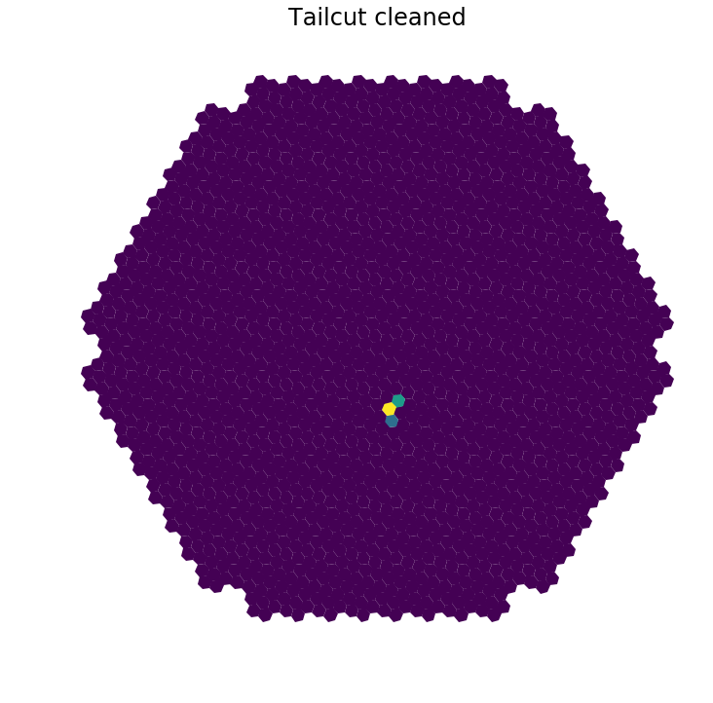
Standard Image Denoising
Issue with faint showers: Information loss
PE (truth)
After Tailcut cleaning
Notes:
Tailcut is fast and simple
Good enough for bright showers
But as it applies a hard cut, it loses signal
It’s an issue for fainter showers (showers with less than 200PE)
Also tailcuts have difficulties to “find” faint showers in the image.

Slide 13
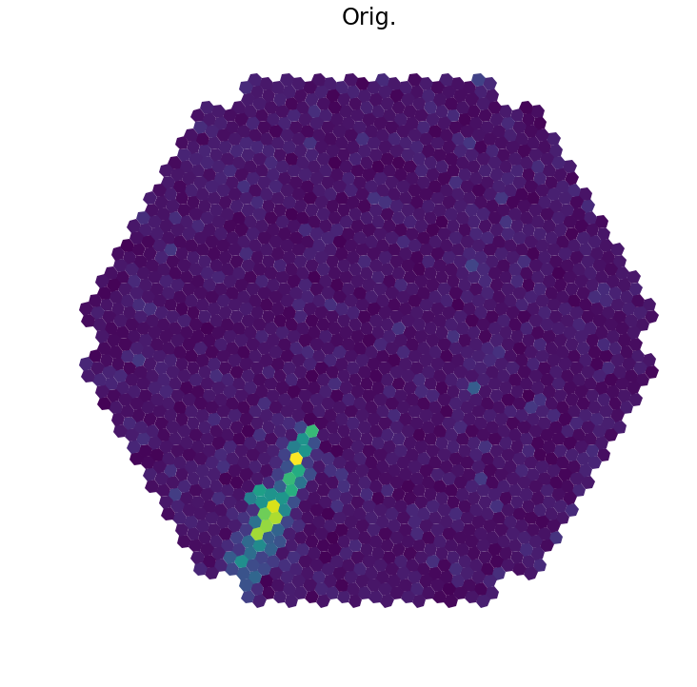
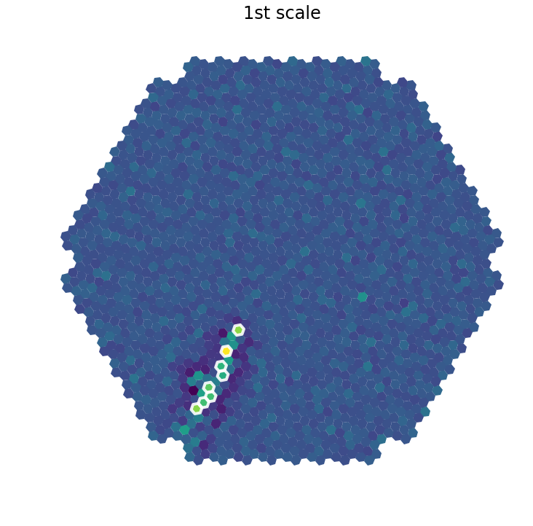
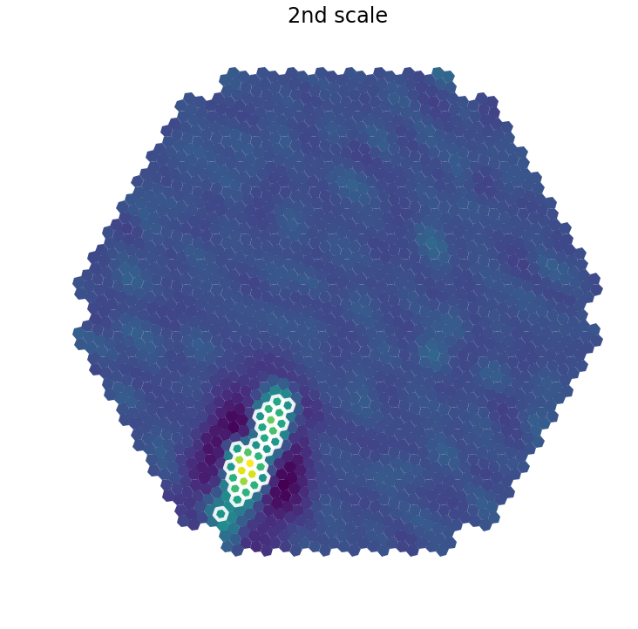
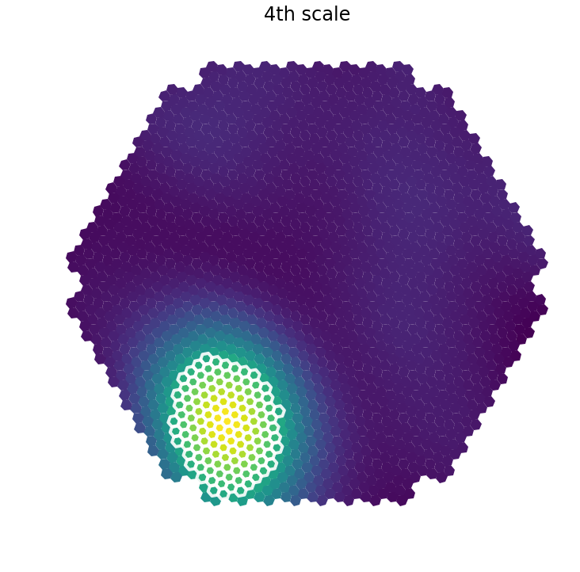
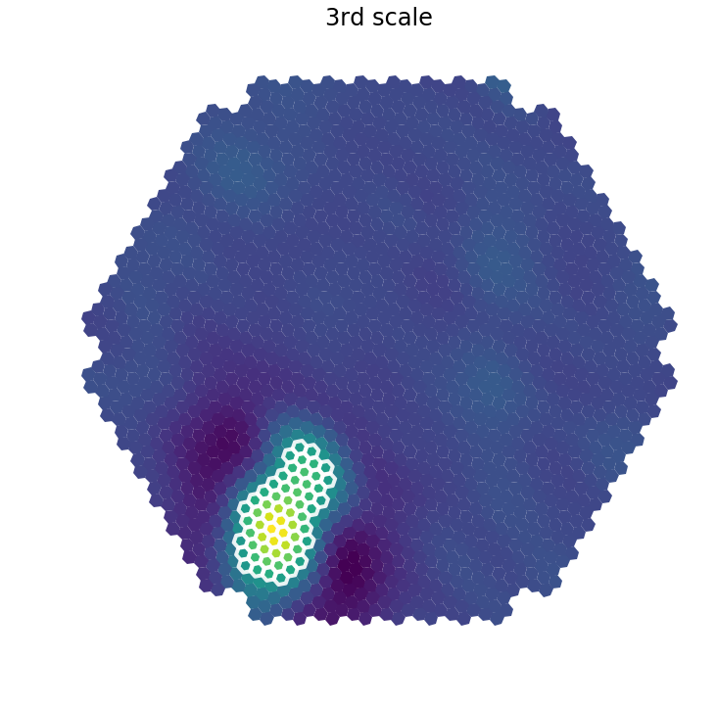
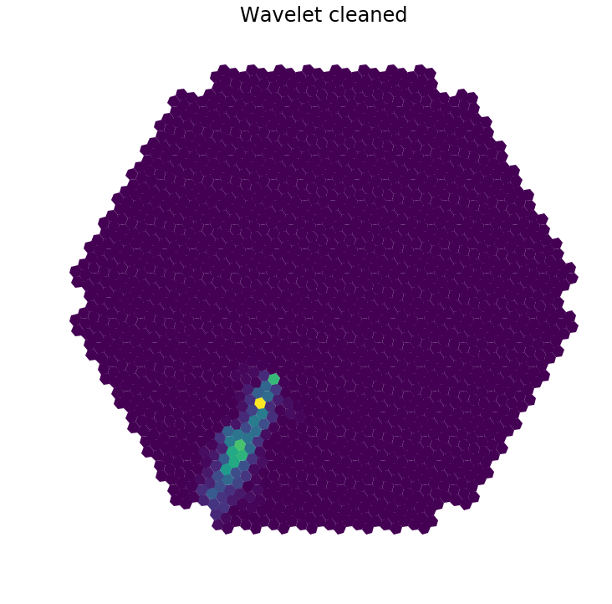
Wavelet filtering of Cherenkov Images
Notes:
And finally, here is an example on an image from an LST monte carlo simulation.
[Here] we have the image to filter
[Here] is its representation in the wavelet transform space
[Here] are the small scale, […] the medium scale, […] the large scale and the residual.
I highlighted in white the pixels that are kept after filtering in each scale.
And [here] the final result after inverting the transform

Slide 14
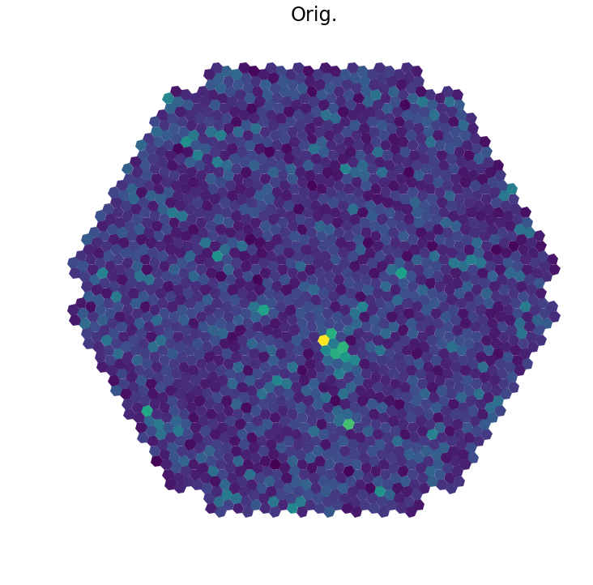
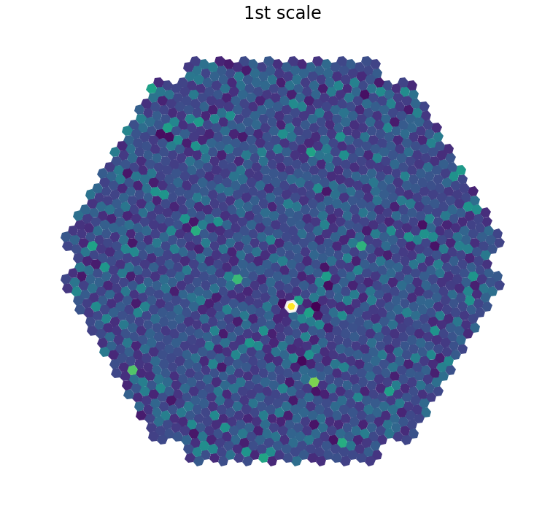
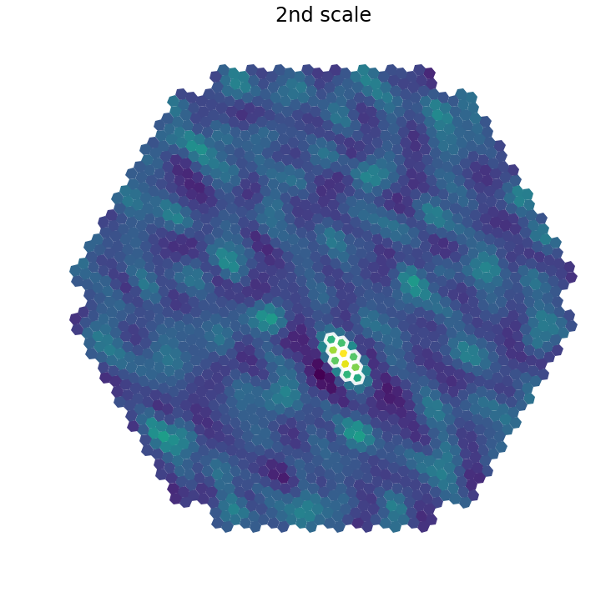
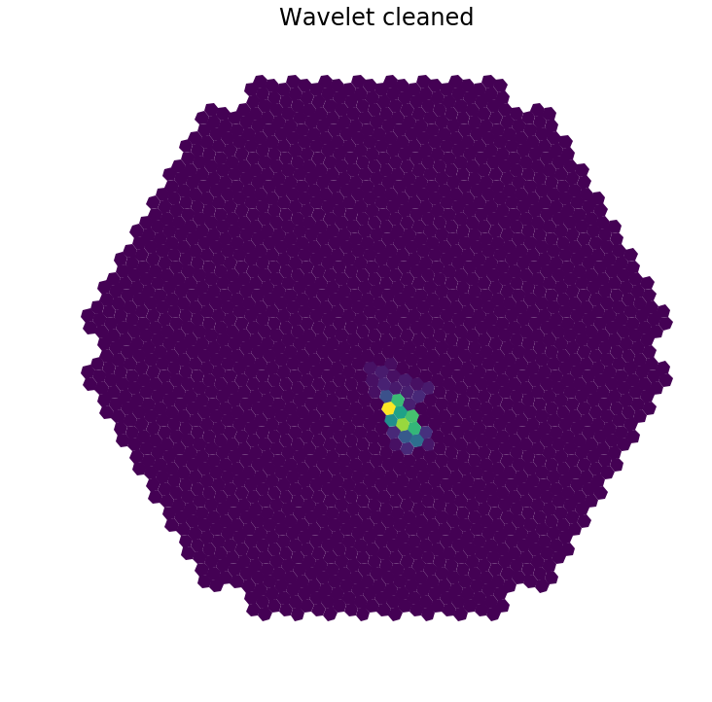
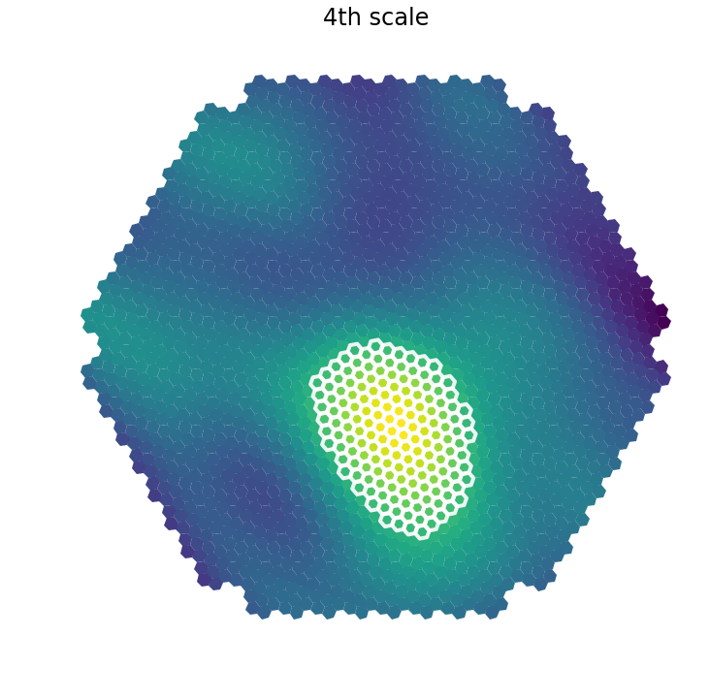
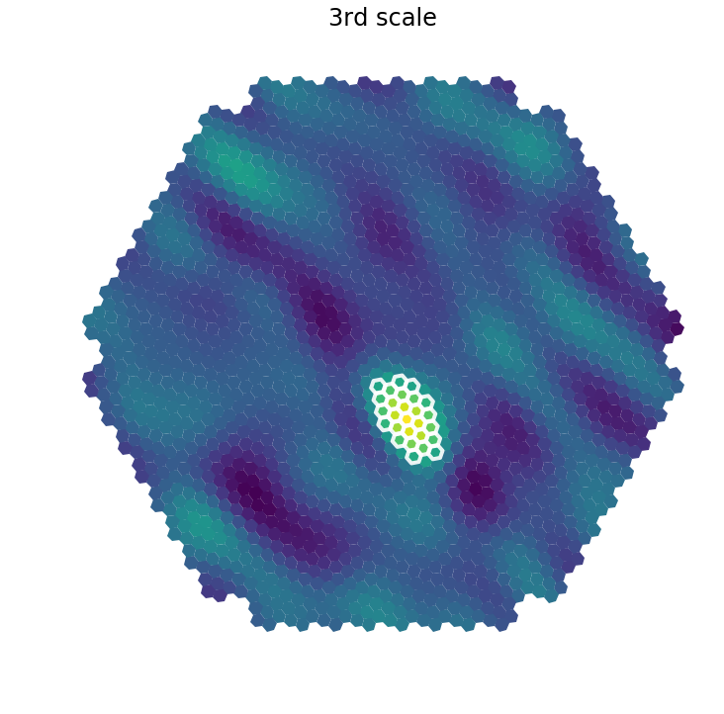
Wavelet filtering of Cherenkov Images
+
+
+
Notes:
And finally, here is an example on an image from an LST monte carlo simulation.
[Here] we have the image to filter
[Here] is its representation in the wavelet transform space
[Here] are the small scale, […] the medium scale, […] the large scale and the residual.
I highlighted in white the pixels that are kept after filtering in each scale.
And [here] the final result after inverting the transform

Slide 15
PE (truth)
Tailcut cleaned
Wavelet cleaned

Slide 16
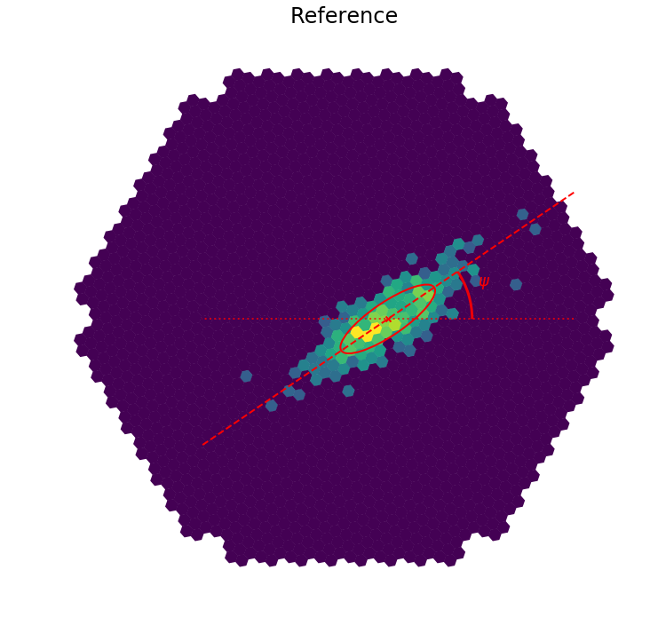
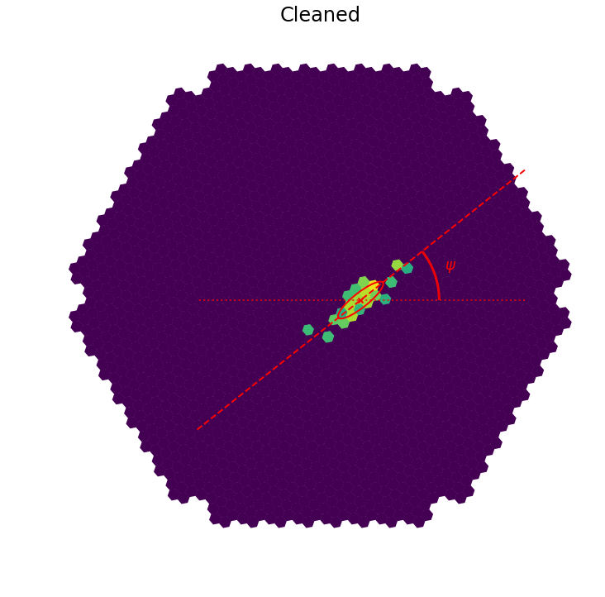
Low-level Metrics
Which thresholds to apply to each wavelet plane is a complex n-dimensional optimization problem
  Want best angular resolution (minimal loss of underlying shape)
  Don't want to lose energy (total signal) in uncorrectable way
Set of image metrics were derived, based on noise-free images to measure performance of the algorithms
Notes:
I use several estimators to assess the performance of the image cleaning,
And among them,
I use the error of the shower axis reconstruction on the image.
It’s the difference between the angle of the shower computed from the “reference” image and the angle of the shower on the cleaned image…
So it’s the difference of those two angles…

Slide 17
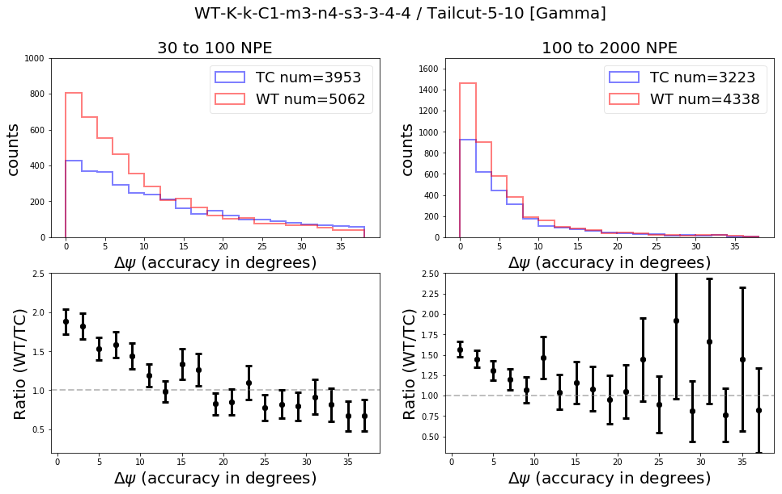
Shower axis reconstruction
SST-1M (gamma)
Similar results for the 5 others camera types
(20-80%)
80% improvement !
Notes:
For SST-1M as an example (siilar results for all cameras)
I looked performance on 2 populations,
The left one contains faint showers
And the right one contains bright showers
Plots at the bottom show the improvement ratio of wavelets compared to Tailcut
So, at this level, it seems quite good as…
For faint showers (the plots on the left) wavelets have more images than tailcut with a precise reconstruction angle of showers and less than Tailcut with a bad reconstruction angle
For brighter showers (the plots on the right), Wavelets are bettor too…
(if we cut at 200 PE -> +30% instead +40%)

Slide 18
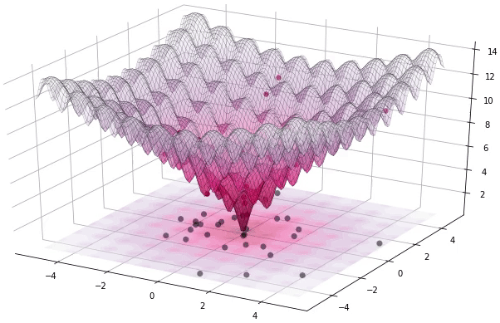
Optimization of Parameters
Rather than use typical astrophysics techniques: learn from optimization experts
Evolutionary minimization algorithms:
  Good for N-D problems
  Less sensitive to local minima
Optimize for set of metrics using large database of Monte-Carlo generated images

Slide 19
High-level metrics
Image metrics tell little about science performance, for that we need to include the algorithm in a full shower reconstruction chain
≈1M gammas
Analysis and reconstruction pipeline
developed locally
Reconstructed gamma-ray candidates
≈1M electrons
≈1M protons

Slide 20
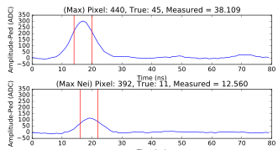
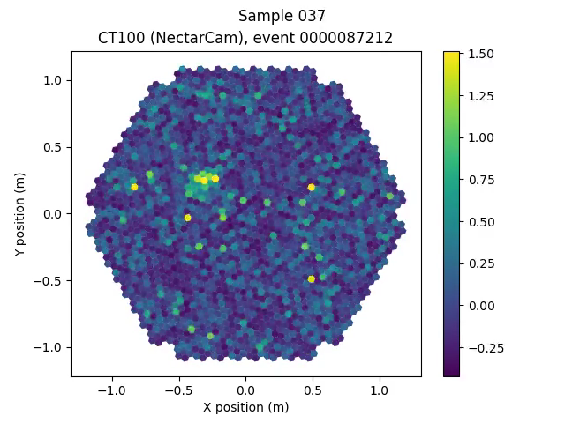
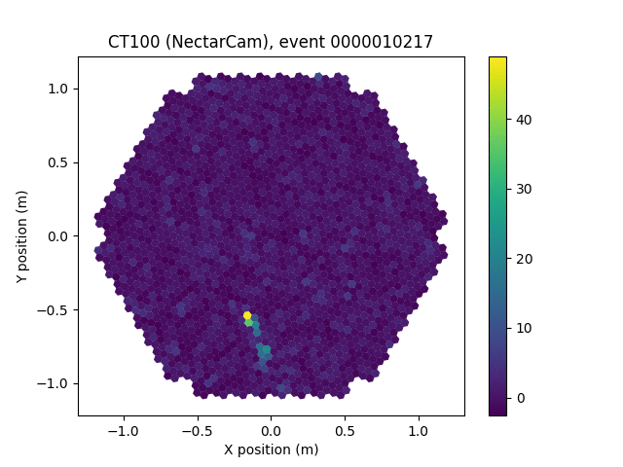
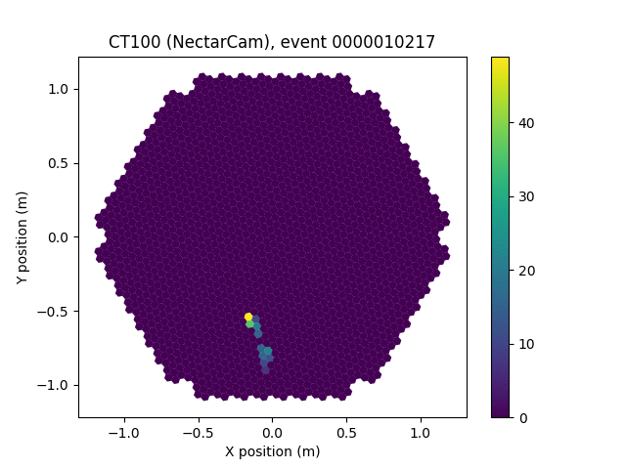
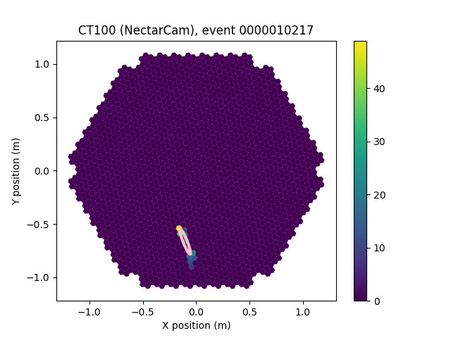
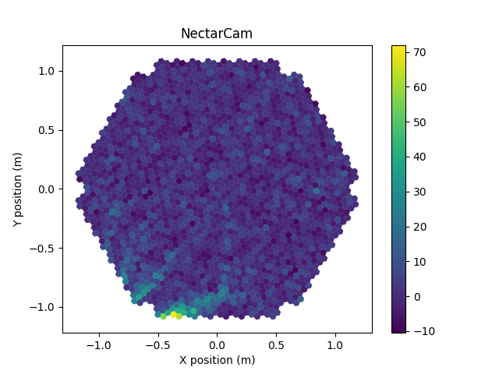
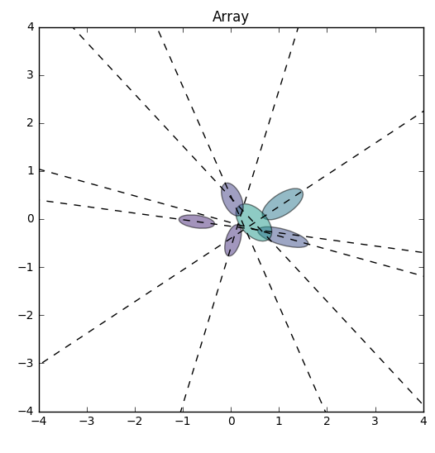
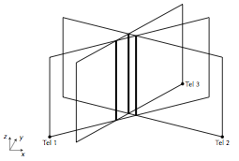
For each camera
K. Kosack ctapipe example
pulse analysis &
integration
de-noising
feature extraction
Combining multiple cameras' views
of the shower
machine-learning
ENERGY | RA | DEC
1.2 | 23.2 | -13.2
0.34 | 23.5 | -14.8
0.1 | 23.1 | -13.1
… | … | …
Hadron rejection
reconstruction
list of gamma-ray candidates
Notes:
Note that all techniques here are tested against FULL monte-carlo sims (from shower particle, tracing the cherenkov light, optics, and electronics of the telescope). Not toy models.

Slide 21
Results from Full Reconstruction
Improvements to shower reconstruction direction
(angle between reconstructed and simulated direction)
20 to 80 % improvement
above 100 GeV

Slide 22

ability to produce science metrics
First sensitivity curves produced
Technique optimized and working on all cameras
UnivEarths Funding Approved
End of postdoc contract
post-doc hired (Nov)
[delay]
2015
2016
2017
…
technique study
implementation and low-level metrics
optimization
performance
study
development of full reconstruction
transfer of knowledge
publication
…
2018
…
transfer of knowledge
publication
development of 3D denoising
application to camera data
application to deep learning
application to transients
if funding/manpower available

Slide 23
What could be done with 6 months?
If by chance we had more funding…
  Apply to a real physics cases
    Low-energy sources, Galactic Center
    High-energy sources, PeVatron sources
  Transfer of knowledge from this project to larger group
  Extend technique
    2D denoising → 3D time-integration + denoising
    Application to deep learning
    (similar techniques, so simple to implement)

Slide 24
Short term publications
Conference Proceedings / Technical Note
  Can achieve relatively fast
  Multiple conferences:
    Purely technical (SPIE 2018, IEEE)
    Science-focused: wavelet techniques
Refereed Journal
  Basic Technique + CTA Pipeline paper could include results as well
  Note: will take longer due to need for e.g. CTA approval (since we used their simulation data)
Mid 2018
2019

Slide 25
Summary
Modern signal processing techniques appear to be very useful for Cherenkov Telescope data
  Improve PSF
  Improve low energy sensitivity
  Immediate applications to CTA and HESS
  Perhaps provide faster data processing
This Work has allowed this group to become experts in gamma-ray analysis, and leaders in CTA science
  Produced improved algorithms
  Produce first full reconstruction chain for CTA
Notes:
… especially to detect faint noisy signal
… like the Inaf group in Italy (Fabio, Tino)
This work has developped a strong collaboration with the cosmostat team

Slide 26
Thank you

Slide 27
Supplemental Info

Slide 28
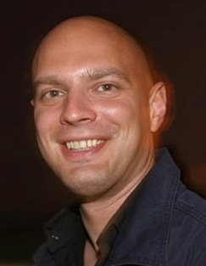
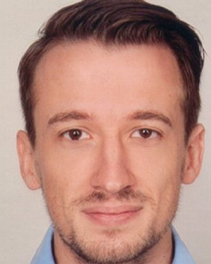
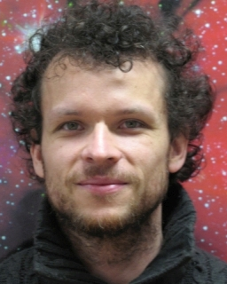
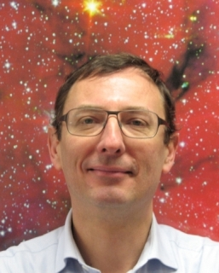
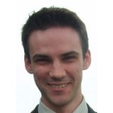
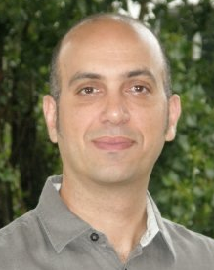
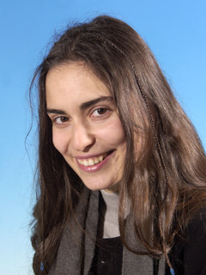
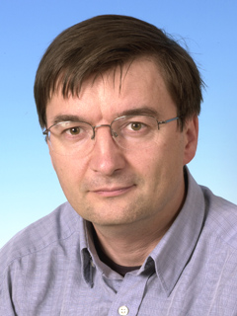
PROJECT MANAGEMENT:
The Team
WP Leader
Jérémie Decock
Karl Kosack
Tino Michael
Fabio Acéro
Thierry Stolarczyk
+
CEA/AIM
CEA/AIM
CNRS/AIM
CEA/AIM
UnivEarths post-doc
Doctor of Computer Science, Inria
Numerical techniques and software development
Mathematical optimization
Signal processing
CTA, ASTERICS
CTA, Fermi
CTA group leader
HESS, CTA
Bruno Khélifi
Sandrine Pires
David Landriu
CNRS/APC
CEA/AIM
CEA/AIM
HESS, CTA
CosmoStat
Euclid, Kepler
LISIS
Fermi, CTA
Notes:
here is our core team.
Here I am,
I'm not an astrophysicist,
I'm a computer scientist,
I've a PhD in mathematical optimization
and I mostly interact with Karl Kosack, Tino Michael, …

Slide 29
Cleaning procedure: general idea with Fourier Transform
Input signal is converted to a weighted sum of sin and cos at different frequencies
Threshold is applied on these weights to remove some frequencies in the input signal (e.g. high pass filter, low pass filter, ...)
Notes:
Wavelet transforms are probably easier to understand when they are compared to Fourier transform
as certainly already know how Fourier transform filtering work:
[here] is a one dimension signal.
With fourier transform,
the input signal is converted to a weighted sum of sine and cosine at different frequencies
Threshold is applied on these weights\
(figures in red)
to remove some frequencies in the input signal
(for instance we may want to remove only high or low frequencies)
(e.g. high pass filter, low pass filter, ...)

Slide 30
Cleaning procedure: general idea with Wavelet Transform
Input signal is converted to a weighted sum of these wavelet functions at different scales (dilate factor) and positions (translate factor)
Threshold is applied on these weights to remove locally (in space or time) some frequencies (or scales) in the input signal
Notes:
With wavelet transform,
the input signal is converted to a weighted sum of these wavelet functions at different scales (dilate factor) and positions (translate factor)
Threshold is applied on these weights to remove locally (in space or time) some frequencies (or scales) in the input signal

Slide 31
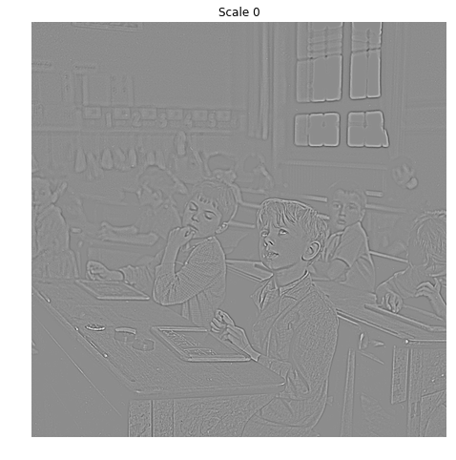
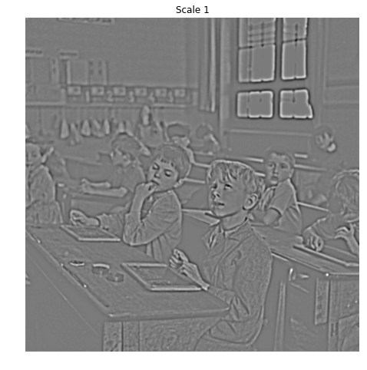
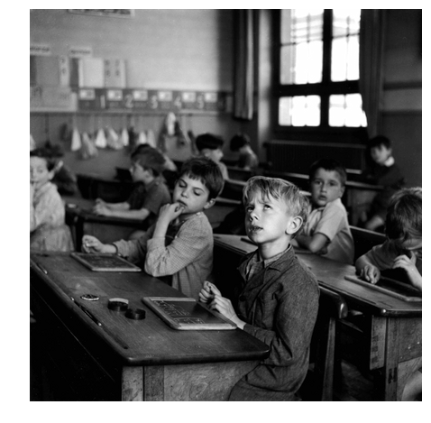
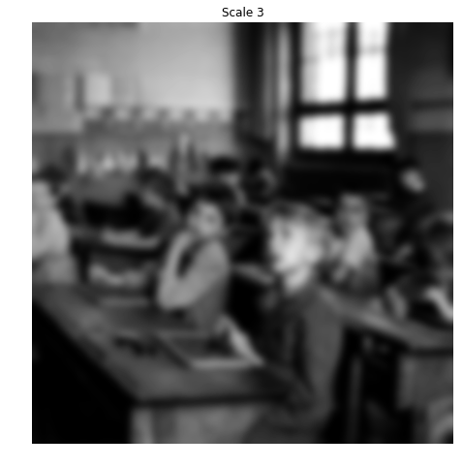

Wavelet transform on images
+
=
+
+
Notes:
This is an example on a 2D signal: an image.
The original image is there
And here are the components of the original image at several scales
Again, the idea is to do filtering on those scales.
(photo: Robert Doisneau)

Slide 32
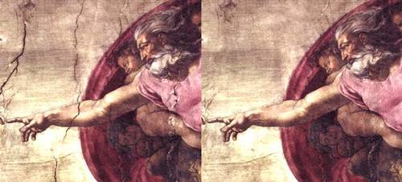
Wavelet Filtering
Remove some scales while preserving others
Notes:
This is an example of the magic of wavelet filtering.
On the left is the original image and on the right the result after wavelet filtering.
Some parts of the medium scale has been removed to erase the cracks [here]
without removing smaller and larger details.

Slide 33
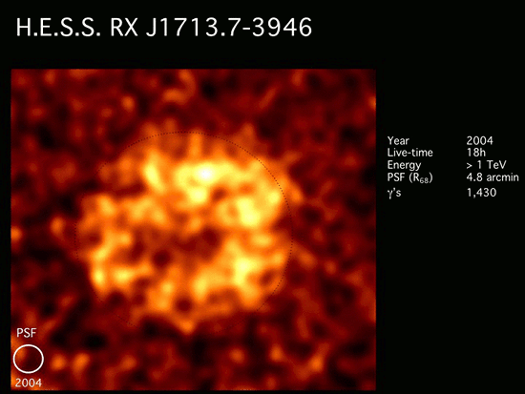

Final Data Products:
Sky Maps and Spectra
Very steep (≈E^{-2.5} spectra)
so low-energy threshold important
Could use this to show what a final sky map looks like (after reconstruction many 1000s of gamms rays)
This is a supernova remnant shell

Slide 34
Results from Full Reconstruction
Improvements to effective detection area

Slide 35
Two steps were needed:
  apply denoising to images
    and try to understand the effect compared to noise-free images
    optimize thresholds for denoising (complex! see slides)
  Include in full reconstruction chain and see global effect on science
    much more complex - denoising has a non-trivial effect on reconstruction

Slide 36
PROJECT:
Focus on two aspects for Cherenkov Telescopes
Gamma-ray reconstruction and discrimination
  Better de-noising and image characterization
  Improve PSF and energy threshold
  Improve data volume reduction with less loss for CTA (factor of 100x needed)
Realtime transient detection
  Wide field-of-view
  Changing detector conditions (atmosphere)
  Complex detector response
  Reduce reliance on calibration and pre-calculated instrumental response functions
Notes:
our project focus on two aspects for Cherenkov telescopes :
... and …
for …
we want a better …
we want to improve PSF... that is to say we want to be able to detect fainter events
we also want to get a better real time discrimination between Hadrons and gamma rays in order to highly reduce the data volume that will be huge with CTA : 10Gb/s
For transient detection, we have
…
It’s less sensitive to instrumental calibration (these alterations are large scale effects)

Slide 37



Cherenkov Image Cleaning
?
Notes:
In order to reconstruct showers
We first need to clean instruments images,
That is to say to remove night sky background instrument’s electronic noise.
This is what I’m working on.
That’s important as improving image cleaning methods
Can improve the accuracy of event reconstruction
and thus it can improve the PSF and the sensibility of the observatory.
PSF = Point Spread Function
My job is to improve the method used to remove Night Sky Background and Instrument Noise on instruments images
In order to improve the accuracy of event reconstruction
and thus improve the PSF and the sensibility of the observatory

Slide 38




Treating Hexagonal Images
Without re-deriving algorithms, want to operate on squared pixels always
  Simplest solution: rotate and shear hexagons
Notes:
Note: preserve pixel values, but distort images and pixel area. Can un-transform to go back to original image after de-noising, however.

Slide 39





Treating Edge Effects
Most algorithms expect rectangular image with all pixels filled in
  Zeroing edges → systematic effect on results
  Better: in-paint with true noise distribution derived from ensemble of images with shower removed (Inverse transform sampling)
Noise distribution can be complex (non-Gaussian): Sum of poisson distributions from discrete photo-electron detections
Still need to worry about internal clipping effects

Slide 40

Shower axis reconstruction
SST-1M (gamma)
Notes:
I have similar results with SST-1M

Slide 41
Shower axis reconstruction
SST-1M (gamma)
Notes:
I have similar results with SST-1M

Slide 42
Shower axis reconstruction
ASTRI (gamma)
Notes:
I looked performance on 2 populations,
The left one contains faint showers
And the right one contains bright showers
Plots at the bottom show the improvement ratio of wavelets compared to Tailcut
So, at this level, it seems quite good as…
For faint showers (the plots on the left) wavelets have more images than tailcut with a precise reconstruction angle of showers and less than Tailcut with a bad reconstruction angle
For brighter showers (the plots on the right), Wavelets are bettor too…
(if we cut at 200 PE -> +30% instead +40%)

Slide 43

Shower axis reconstruction
FlashCam (gamma)

Slide 44

Shower axis reconstruction
NectarCam (gamma)

Slide 45

Shower axis reconstruction
LSTCam (gamma)

